Slide 1
Project title
CAPSTONE PROJECT
Presented By:
Student Name- SUVASINI
College Name- CMR University
Department- CSE

Slide 2
OUTLINE
Problem Statement (Should not include solution)
Proposed System/Solution
System Development Approach (Technology Used)
Algorithm & Deployment
Result
Conclusion
Future Scope
References

Slide 3
Problem Statement
.
Students often struggle to understand complex academic concepts while studying independently.
Searching online frequently yields lengthy, irrelevant, or overly technical results that don't match the student's level of understanding.
Teachers and tutors are not always available for instant doubt resolution, especially outside classroom hours.
There is no personalized, on-demand tool that can explain topics simply, summarize notes, and generate quizzes or flashcards tailored to each student's needs.
Existing study tools lack AI-driven adaptability, making self-study inefficient and frustrating for many learners.

Slide 4
Proposed Solution
Build an AI-Powered Study Buddy web application that uses large language models (LLMs) to assist students in real-time.
The tool will explain complex topics in simple, student-friendly language with step-by-step breakdowns.
It will summarize uploaded study notes or pasted text into concise, digestible points.
On-demand quiz and flashcard generation from any topic or material, enabling active recall and self-assessment.
A chat-based interface that feels natural and interactive, available 24/7 with no waiting time.

Slide 5
System Approach
Frontend: React.js with TypeScript and Tailwind CSS for a responsive, modern UI.
Backend: Supabase Edge Functions (serverless) to handle AI API calls securely.
AI Model: Google Gemini API for topic explanation, summarization, and quiz generation.
Architecture: Client sends user queries → Edge Function processes with AI → Streams response back to the user in real-time.
Deployment: Frontend deployed on Vercel
Backend deployed via Supabase Edge Functions.

Slide 6
Algorithm & Deployment
Input Processing: User inputs a topic, question, or pastes study notes into the chat interface.
Prompt Engineering: The system constructs a context-aware prompt with the appropriate mode (explain, summarize, or quiz).
AI Inference: The prompt is sent to Gemini LLM via a secure backend edge function; response is streamed token-by-token.
Output Rendering: Markdown-formatted responses are rendered in the chat UI with proper formatting for lists, code, and headings.
Deployment: Frontend deployed on Vercel (auto-build from GitHub)
Backend deployed using Supabase Edge Functions
AI requests securely handled via serverless functions
.

Slide 7
Result
Successfully built a functional AI Study Buddy that can explain topics, summarize notes, and generate quizzes on demand.
The chat-based interface provides instant, clear, and student-friendly responses powered by Google Gemini AI.
Students can interact naturally by typing questions or pasting study material and receiving structured, easy-to-understand answers.
The system handles multiple modes seamlessly — explanation, summarization, and quiz generation — all within one interface.
Real-time streaming ensures fast response delivery without long wait times.

Slide 8
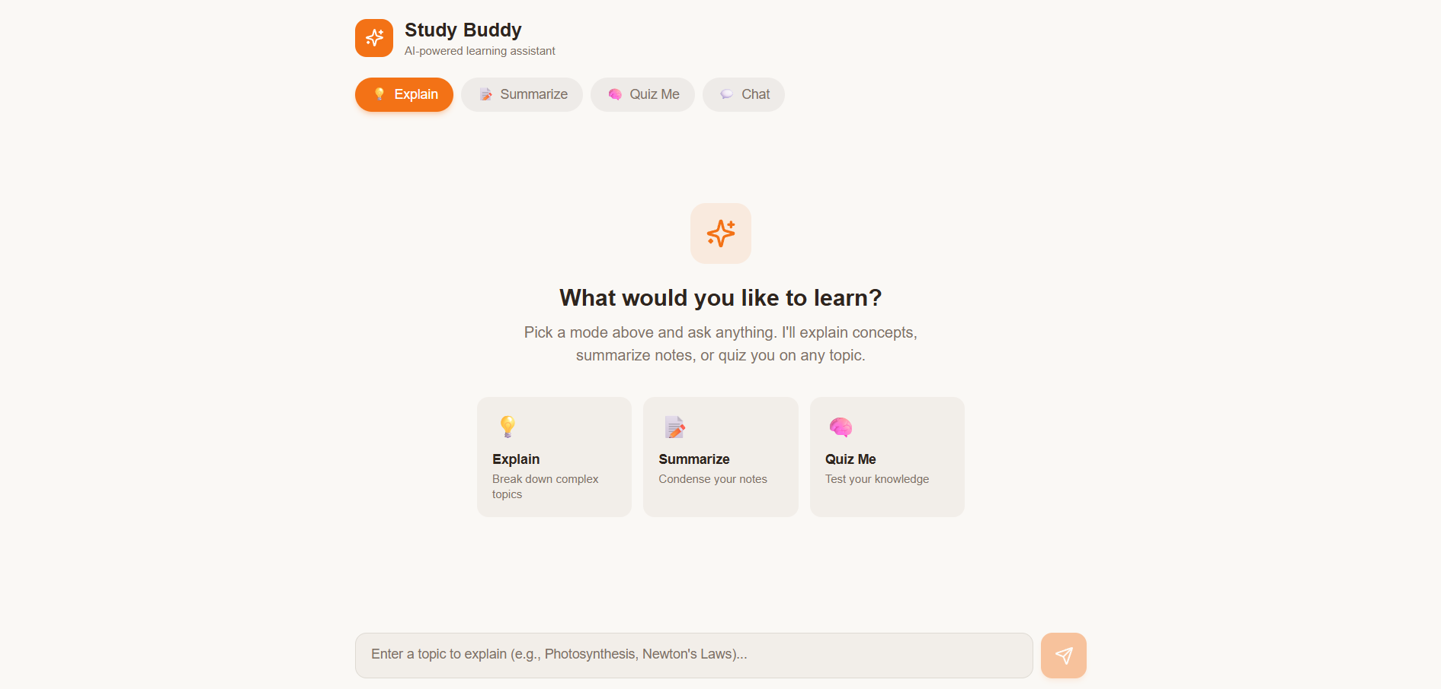

Slide 9
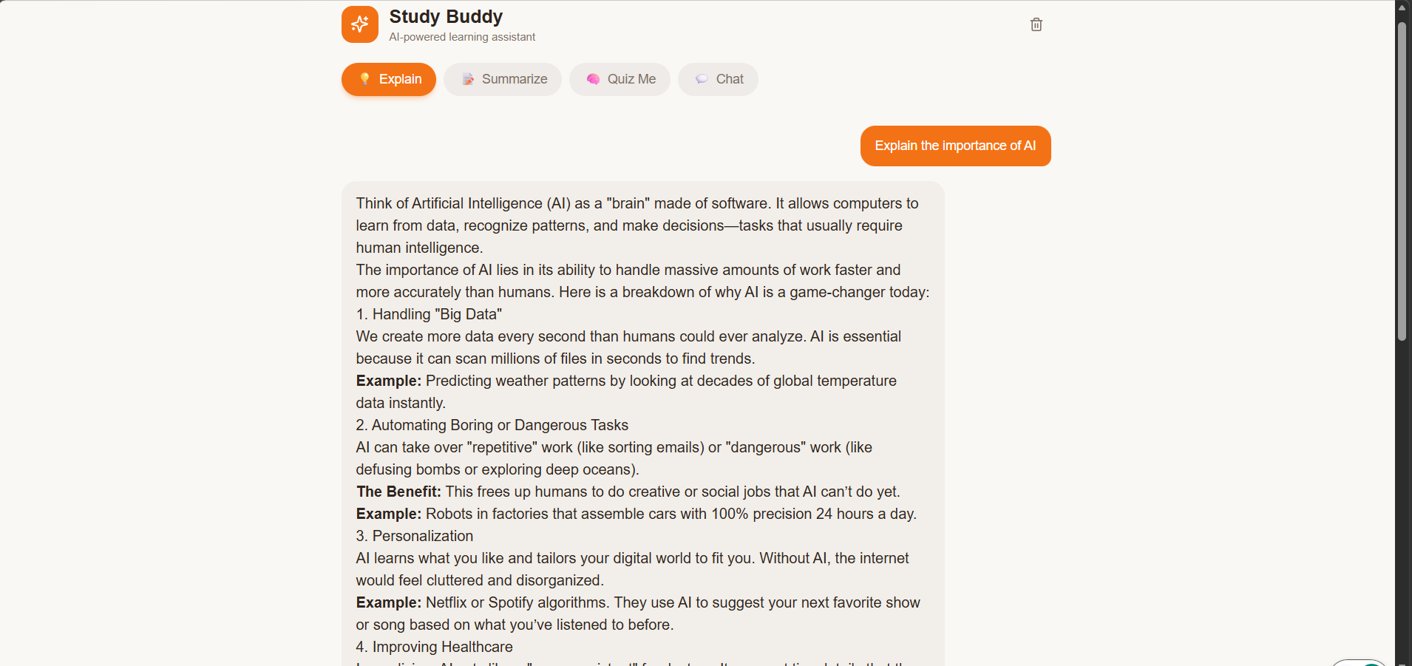

Slide 10
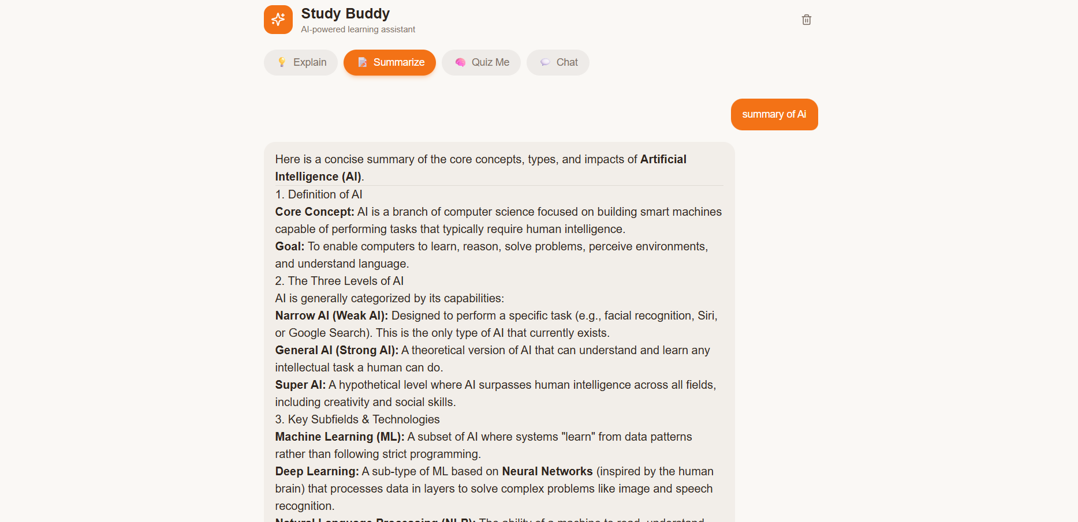

Slide 11
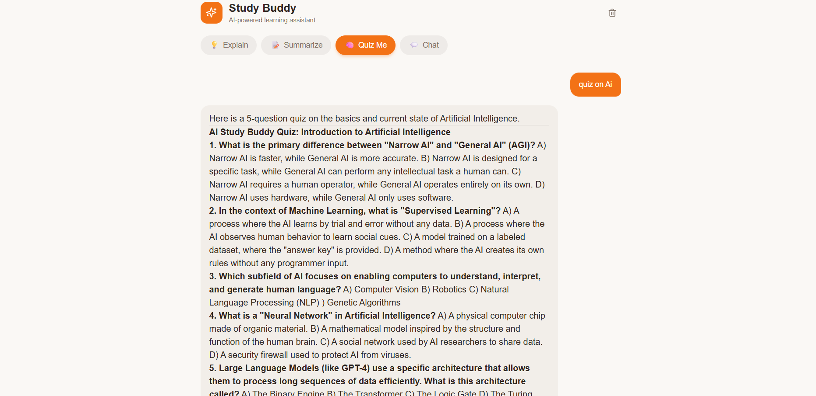

Slide 12
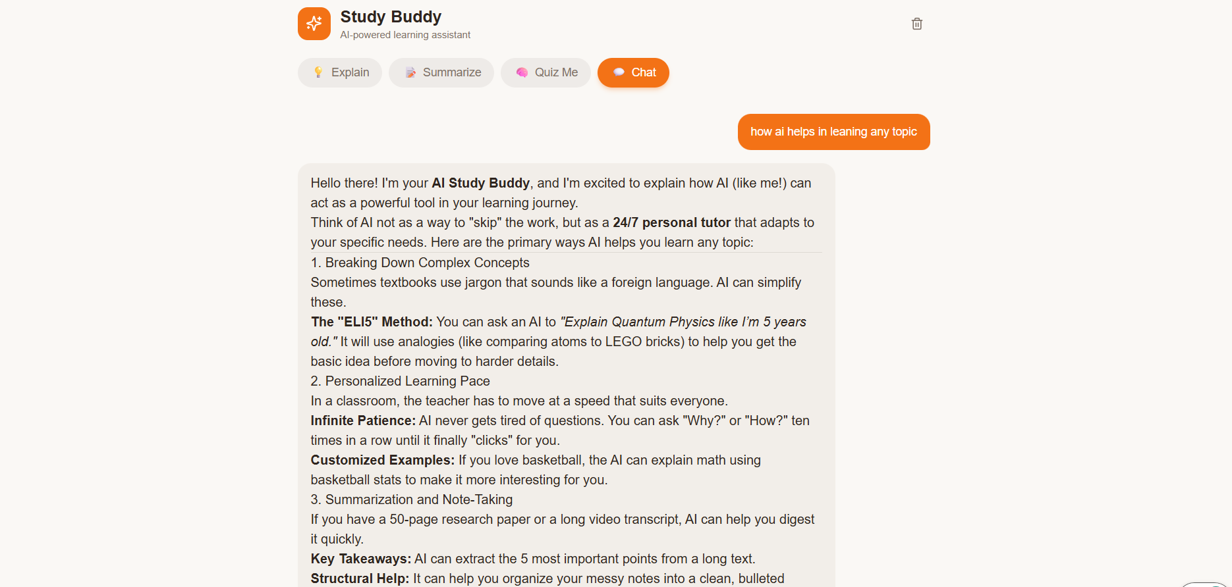

Slide 13
Conclusion
The AI-Powered Study Buddy effectively addresses the gap between students' learning needs and the availability of instant, personalized academic help.
By leveraging modern AI capabilities, the tool makes self-study more efficient, interactive, and accessible for students across all levels.
The project demonstrates how AI and web technologies can be combined to create impactful educational tools with minimal infrastructure overhead.
It serves as a practical capstone project showcasing full-stack development, AI integration, and user-centric design principles.

Slide 14
Future scope
Add voice-based interaction so students can ask questions verbally and receive spoken answers.
Integrate PDF/document upload for automatic summarization and quiz generation from study materials.
Implement user authentication to save chat history, track progress, and personalize learning paths.
Add multi-language support to help students study in their preferred language.
Build a spaced repetition system using generated flashcards to optimize long-term retention.

Slide 15
References
Google Gemini AI – ai.google.dev
React.js – react.dev
Tailwind CSS – tailwindcss.com
Supabase – supabase.com

Slide 16
Github link
Github Link : https://github.com/Suvasini911/studypla-ai.git
Deployment Link: https://quick-grasp-guide-9l4z74a60-suvasini911s-projects.vercel.app?_vercel_share=kGgygo1ym5IFLj6I3Z3yc0wCWUQDSAGb

Slide 17
THANK YOU

